Slide 1
GCSE Business Studies
2025/26 Academic Year

Slide 2
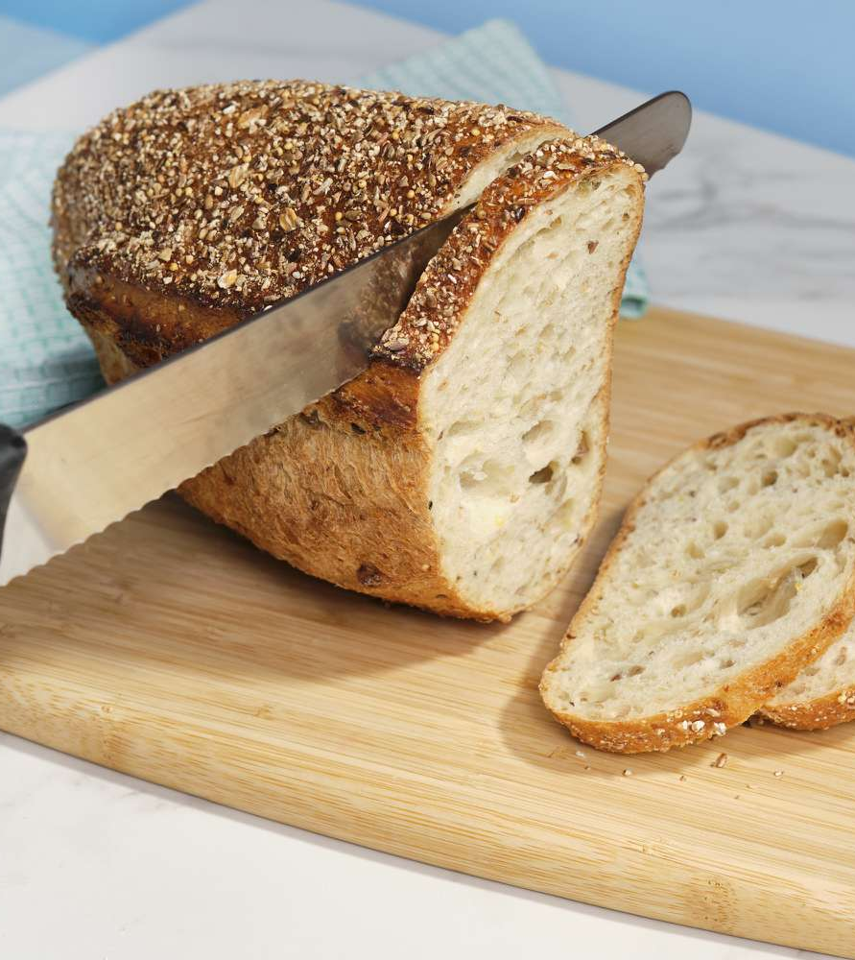
Making a Difference
Do you want to help others and make a difference in the world?
“The single-most important factor in building a successful business is in solving problems for other people”
This is HUGELY rewarding

Slide 3
Do you know how to put a great idea into practice?
Are you good at solving problem after problem?
Do you want to become a better numbers person?
Do you want to better understand revenue and profit, break-even and cash flow?

Slide 4
Are you prepared for the ups and downs of business?
Business is tremendous fun, but it isn’t without its ups and downs
Learn how to seize opportunities and deal with threats

Slide 6
By choosing GCSE Business
You will learn:
How new business ideas come about
The skills and attributes an entrepreneur needs to turn an idea into a business
The role of external factors, such as technology, in driving change in business

Slide 7
The great business idea
Nick thought he had a great business idea:
Establish a factory to make a product that every child wants
Distribute it around the world
Sit back and enjoy the rewards
Sounds like a fool proof plan?
How would this go down in the Dragon’s Den?
What would business magnate, Lord Sugar, make of the plan?

Slide 8
Could you do better than Nick?

Slide 9
You will learn
What drives an entrepreneur to succeed
How businesses respond to new technologies
How a business manages its money and people
How a business finds and targets its customers

Slide 10
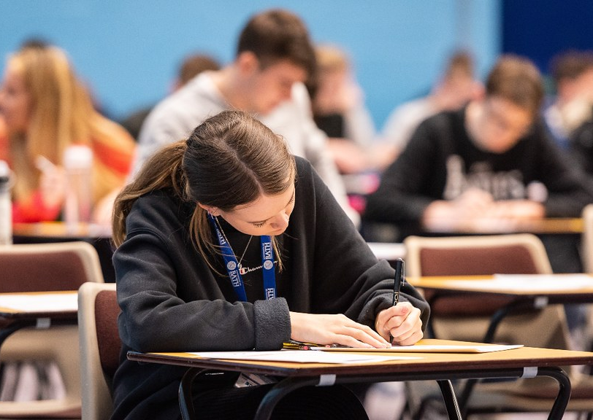
Assessment
The GCSE is assessed through two external exams
Each exam is 1 hour and 45 minutes and worth 50%
Students are expected to write essay style questions in each paper
GCSE Business Paper 1: Influences of operations and HRM on business activity
GCSE Business Paper 2: Influences of marketing and finance on business activity

Slide 11
FAQ
Is there coursework involved in Business Studies?
No, however, you will be set regular exam style questions (every lesson) to prepare you for the end of year exam, with formal and continuous assessments
Can I become a businessman if I take this subject?
Business Studies is the study of businesses and the operations that drive their success.
For any further questions, please contact the Head of Business Studies:
Mr. Mahmoudi
a.mahmoudi@hurstmere.org.uk
Do I need to be good at Maths to study Business Studies?
While you don’t need to be a Maths expert, an understanding of numbers and how to interpret data is important in Business Studies. Some topics, like finance and accounting, will involve calculations and analysis, so a good grasp of Maths is helpful.
Is the exam hard?
Each exam lasts 1 hour and 45 minutes and requires you to think critically, applying your theoretical knowledge to real-life business situations. It is a challenging exam and will require substantial study and preparation at home.
How can I prepare for the Business Studies exam? To succeed, you should review class notes daily, stay up-to-date with current business news, practice exam-style questions, and focus on understanding key concepts and their real-world applications. Regular revision and applying theory to practical scenarios will be key to your success

