Slide 1
GCSE Mathematics
An insight into the course, assessment and expectations

Slide 2
GCSE Mathematics (8300)
Maths is for everyone. It is diverse, engaging and essential in equipping students with the right skills to reach their future destination, whatever that may be.
AQA have designed their course to support pupils to engage with, explore, enjoy and succeed in Maths by putting students at the heart of everything.
The question papers are designed with students in mind. Committing to ensuring that students are settled early for their exams and have the best possible opportunity to demonstrate their knowledge and understanding of Maths, to ensure they achieve the results they deserve.

Slide 3
Tier of Entry & Grading
This will be a two-year GCSE Mathematics course and entry is at one of two tiers: Foundation tier (grades 1-5) and Higher tier (grades 4-9).
Pupils must complete three question papers at the same tier; all question papers must be taken in the same series.

Slide 4
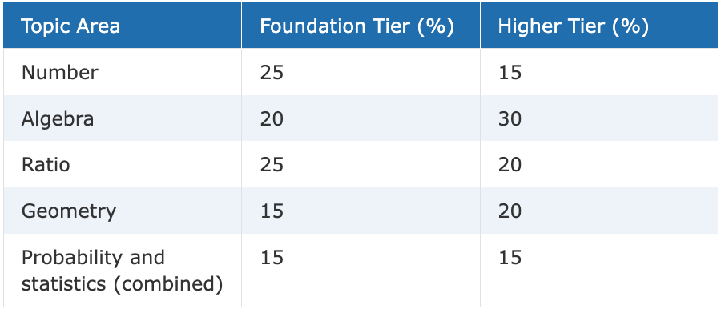
Insight into the Specification
All content can be assessed on any of the three question papers.
As such, some questions will draw together elements of maths from different topic areas.
The weighting of the topic areas has been prescribed by Ofqual and is common to all exam boards. The table above shows the approximate weightings of the topic areas for the overall tier of assessment, not for each individual question paper.

Slide 5
Assessment Structure
Wholly assessed by the written examination at the end of Year 11.
A final grade is awarded based on the combined marks of all papers.
Paper 1 (Non-calculator)
Written Paper: 1 hour 30 minutes (80 marks)
33.3% of the GCSE Mathematics assessment
Paper 2 (Calculator)
Written Paper: 1 hour 30 minutes (80 marks)
33.3% of the GCSE Mathematics Assessment
Paper 3 (Calculator)
Written Paper: 1 hour 30 minutes (80 marks)
33.3% of the GCSE Mathematics Assessment

Slide 6
Expectations
After EVERY assessment, students are either…
Happy with their results
Unhappy

Slide 7
Expectations
Unhappy
DO NOT WORRY!
Happy with their results
BRILLIANT – WELL DONE!
Don’t be complacent
Three papers – you need to do well in all
Different skills are tested on each of the papers
HUGE Competition outside of the classroom – for jobs/apprenticeships, etc
Be as aspirational as possible
Get feedback from your class teacher early on to identify the misconception.
Attend regular after-school revision sessions provided.
Use your online Maths learning platform regularly to do independent home study.
Try something different NOW, don’t keep doing the same thing.

Slide 8
Expectations

Slide 9
Useful Resources
Knowledge Organisers
AQA Revision Guides
Online Maths learning platforms
Practice Papers
Resources uploaded onto Teams

